Slide 1
Discovering Reactive extensions
- through the power of music (not clickbait) -

Slide 2

Reactive extensions
Library for working with asynchronous streams
Implemented in multiple languages (Java, JavaScript, C#, Swift)
How does it work?

Slide 3

Observer pattern
I forgot what that is…

Slide 4


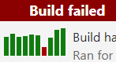
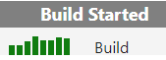

Observer pattern
Paul: Ponder life decisions
Paul
Notify
Subscribe
Notify
Subscribe
Madalin
Madalin: Give up on life

Slide 5
How do I use it?

Slide 6

Observables / Observers
What are those?

Slide 7




Observables
Observers
We look so cool like this
♪ tut tuuut ♪
We look so cool like this
And a 1, 2
1, 2, 3…
GO
♪ tuuut tut ♪
♪ dum ♪
♪ dum ♪
♪ dum ♪

Slide 8
Can you do both at the same time tho?

Slide 9

Subjects
Aaaaand… go
♪ boom ♪
I should find some friends
♪ boom ♪
♪ boom ♪

Slide 10

Cool! How do I make some?

Slide 11

OPERATORS!
Geez… you don’t have to scream

Slide 12

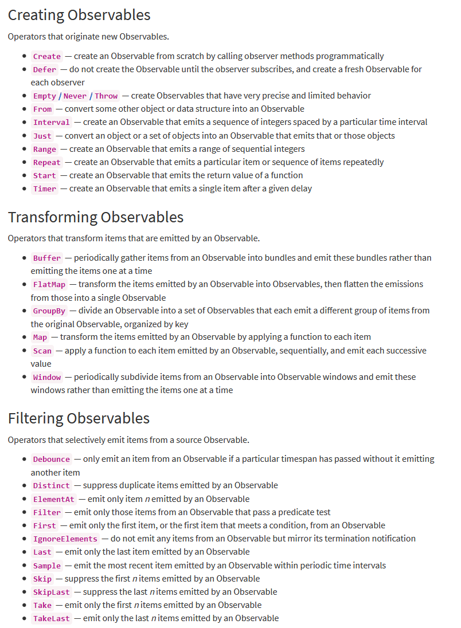
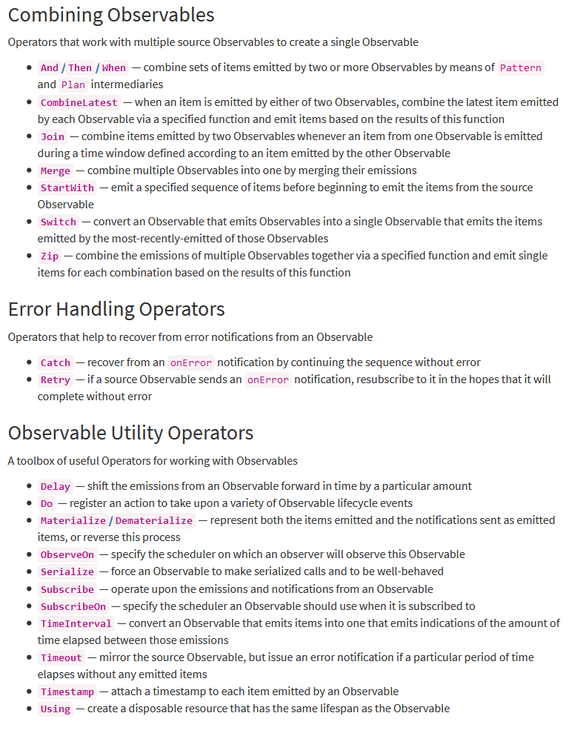
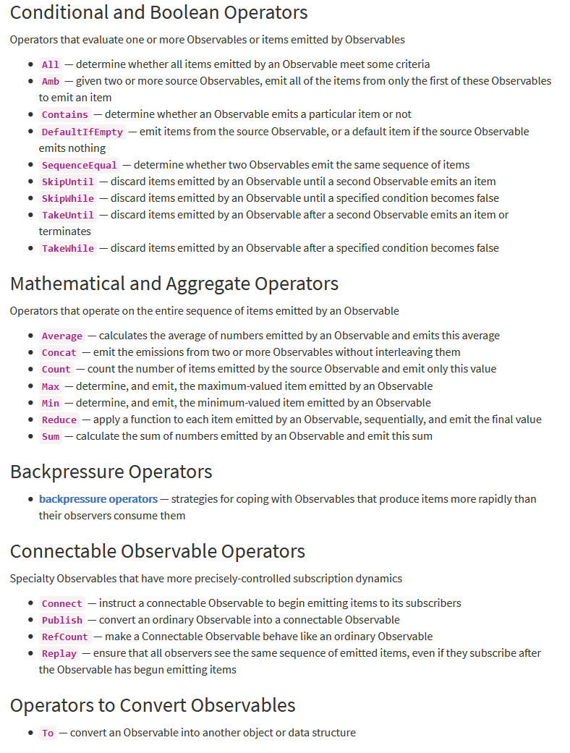
Operators
Umm… can you show me an example?

Slide 13

Code time
I got my glasses on.
LET’S CODE!
Notes:
https://github.com/paul-antal/ReactiveMusic.git

